Slide 1

HELP Toolkit Webinar
January 26th 2023
Supporting the Health of Survivors of Family Violence in Family Law Proceedings
Notes:
Lisa

Slide 2
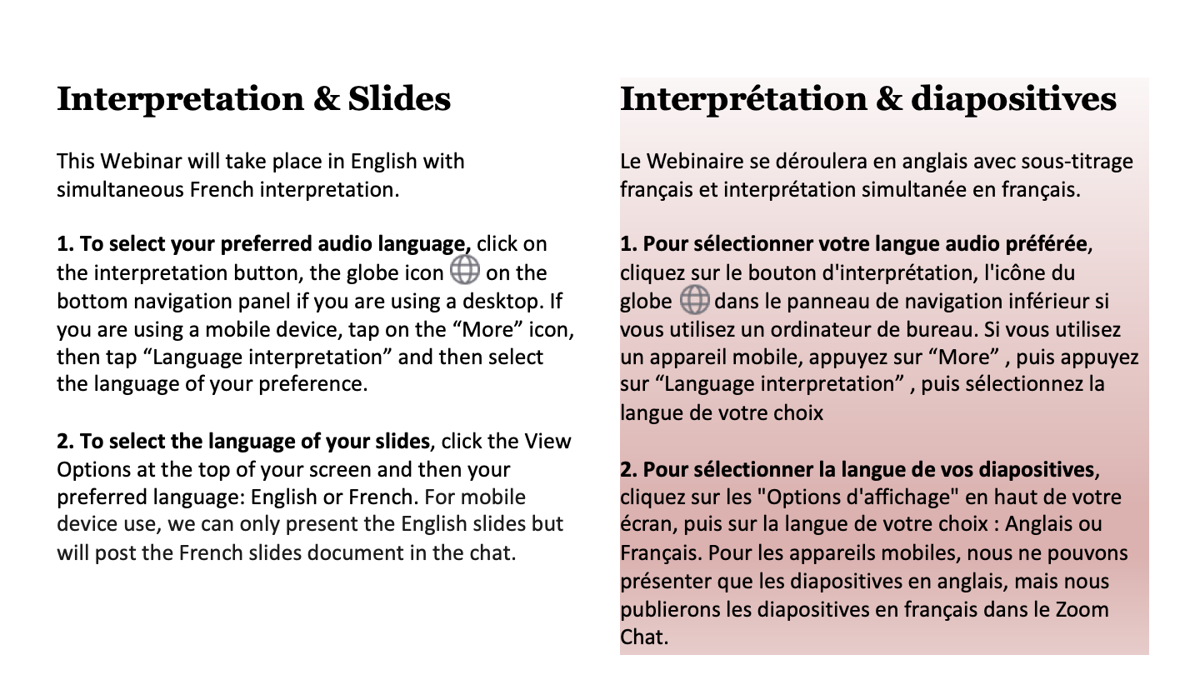

Slide 3


Please think about the traditional lands you are currently situated on and join us in acknowledging and thanking the generations of Indigenous peoples who have cared for these Lands and in celebrating the continued strength and spirit of Indigenous Peoples. The ongoing work to make the promise of truth and reconciliation real in our communities and in particular to bring justice for murdered and missing Indigenous women and girls across the country should inform our discussions in this webinar and beyond.
Notes:
Katreena

Slide 4
Cherami Wichmann (she/elle)
Chermani is a Senior Social Science Researcher with the Research and Statistics Division, at the Department of Justice Canada. Cherami attained her in PhD in Psychology in 2001 with a focus on quantitative methods and developmental psychopathology. Cherami has undertaken research on family law issues with Justice Canada since 2001. Cherami is the Federal Co-Chair of the Research Sub-Committee of the Federal- Provincial- Territorial Coordinating Committee of Senior Officials – Family Justice. Cherami was the project lead for the HELP Toolkit: Identifying and Responding to Family Violence for Family Law Legal Advisers.
Notes:
Lisa

Slide 5
Bianca Stumpf (she/elle)
Bianca Stumpf is a Junior Researcher with the Research and Statistics Division at the Department of Justice Canada. She is a qualitative social science researcher by trade and graduated with a Masters of Arts in Sociology from the University of Ottawa in 2019. Her areas of research tend to focus on family law, child and youth victims of crime, and youth justice. Bianca was a key member of the team that developed the HELP Toolkit: Identifying and Responding to Family Violence for Family Law Legal Advisers.

Slide 6
Robin Trombley (she/elle)
Robin is a lawyer with the Family and Children’s Law Team at the Department of Justice Canada. She has worked in a variety of policy areas including crime prevention, victims of crime, youth justice, family law and family violence. An important focus of her current work is improving family justice system responses to family violence. Robin was also a key member of the team that developed the HELP Toolkit: Identifying and Responding to Family Violence for Family Law Legal Advisers.

Slide 7
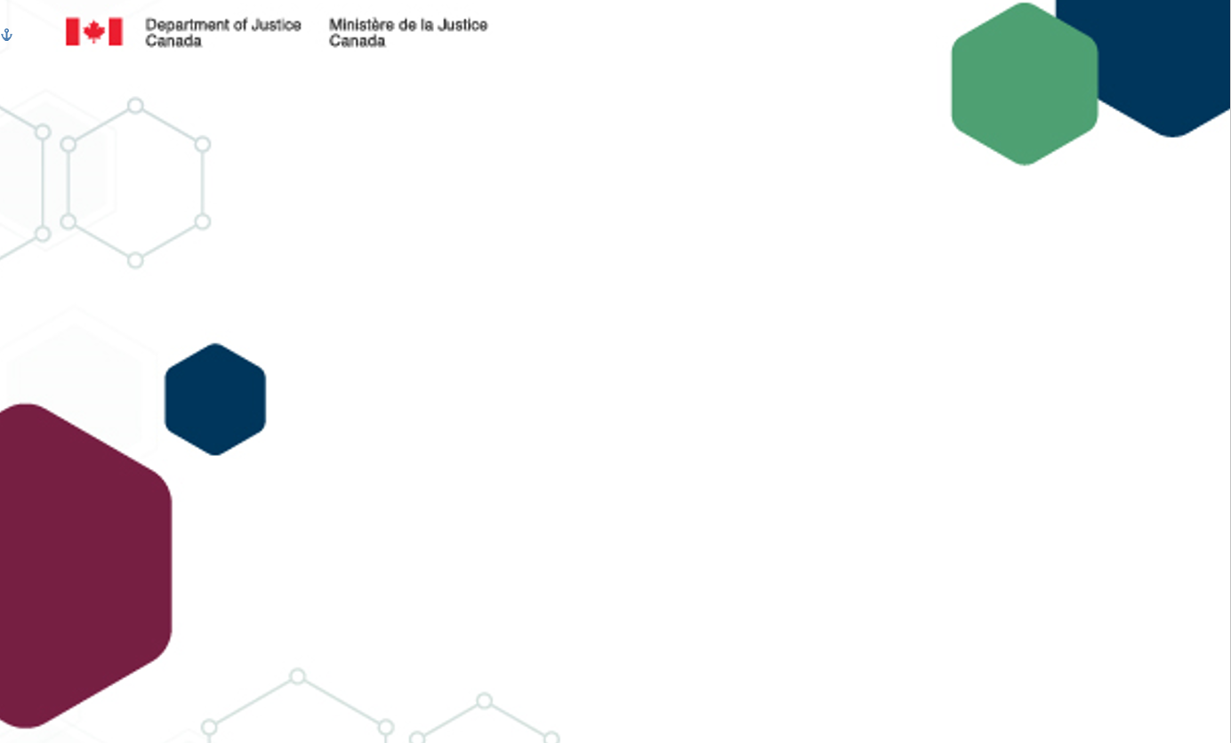
HELP Toolkit: Identifying and Responding to Family Violence for Family Law Legal Advisers
Supporting the Health of Survivors of Family Violence in Family Law Proceedings
Department of Justice Canada
January 26, 2023
Notes:
DOJ team

Slide 8



Identifying Family Violence in Family Law Cases: Justice Canada Research
2018 National Family Law Program Survey
Around half of lawyers report usually screening for family violence
Majority of lawyers do not use a standard tool to identify family violence
Luke’s Place report: What You Don’t Know Can Hurt You: The importance of family violence screening tools for family law practitioners (2018): https://www.justice.gc.ca/eng/rp-pr/jr/can-peut/index.html
No universal family violence tools have been designed specifically for use by family law lawyers in Canada
2

Slide 9

HELP Toolkit: The Development of a Collaborative and User-Based Resource for Legal Advisers
9

Slide 10




Purpose and Overview of Tool
fills a gap identified in prior research (Luke’s Place, etc.)
complements training and
PLEI developed by JUS
and others on family violence/law
user-based development and approach
“bottles” the approach taken by experts in the area in a practical way including scripts
incorporates cultural awareness and safety & a trauma- and violence-informed approach
addresses concerns of legal advisers
10

Slide 11
Collaborative and User-Based Development
Research on family violence in diverse populations
Family law legal advisers
Partnerships with WAGE and PHAC
Family violence experts
HELP
Toolkit
Technical experts
Frontline service providers
Research with family law clients
Family law professionals with a family violence focus

Slide 12




Incorporating Trauma- and Violence-Informed Principles and Cultural Safety and Awareness
Worked with the lead of the VEGA project (funded by PHAC) to develop the HELP Guide on how to have a discussion about family violence.
Worked with recognized experts in cultural safety to develop a resource on cultural safety for the toolkit.
.
Incorporated content from papers written by subject matter experts working closely with persons from diverse communities who experience family violence..
Will develop a companion piece that incorporates findings from three papers written by experts from the three distinction-based Indigenous groups on what to consider when identifying and responding to family violence.

Slide 13
HELP Approach
H
E
L
P
HAVE
an initial discussion about family violence
EXPLORE
immediate risks and safety concerns
LEARN
more about the family violence to help you determine what to recommend to your client
PROMOTE
safety throughout
the family law case
13

Slide 14
Why Don’t We Call It a “Screening” Tool?
Criticism of the concept of “screening”:
  Implies asking potentially re-traumatizing questions without necessarily having an impact on the response
  Concerns about asking for the sake of asking
The Toolkit is intended to help legal advisers inquire about family violence and then integrate that information into practice.
14

Slide 15
HELP Toolkit Is Specifically Developed Around the Divorce Act Family Violence Provisions
Evidence-based definition: s. 2(1)
family violence means any conduct, whether or not the conduct constitutes a criminal offence, by a family member towards another family member, that is violent or threatening or that constitutes a pattern of coercive and controlling behaviour or that causes that other family member to fear for their own safety or for that of another person — and in the case of a child, the direct or indirect exposure to such conduct — and includes (…)
15

Slide 16
Divorce Act: Family Violence Definition (cont’d)
(a) physical abuse, including forced confinement but excluding the use of reasonable force to protect themselves or another person;
(b) sexual abuse;
(c) threats to kill or cause bodily harm to any person;
(d) harassment, including stalking;
(e) the failure to provide the necessaries of life;
(f) psychological abuse;
(g) financial abuse;
(h) threats to kill or harm an animal or damage property; and
(i) the killing or harming of an animal or the damaging of property;
16

Slide 17
Family Violence Provisions
Primary consideration: child’s safety, security and well-being (16(2))
Best interests of the child criteria specific to family violence cases – court required to consider family violence and its impact (16(3) & 16(4))
Supervised parenting time and transfers (16.1(8) & 16.5(7))
Prohibition on the removal of a child from a geographic area without the written consent of any specified person or without a court order authorizing the removal (16.1(9))
Exceptions to notice of changes of residence and relocation (16.8(3), 16.9(3), 16.94(3))
Provision to promote coordination between criminal, child protection and family cases (7.8)
17

Slide 18
Divorce Act Strongly Encourages “Family Dispute Resolution”
As part of focusing on the best interests of the child and promoting a more efficient family justice system, the Divorce Act amendments have a strong focus on promoting “family dispute resolution” (FDR).
  Parents have a duty to try to resolve disputes through FDR to the extent that it is appropriate (7.3)
  Legal advisers have a duty to encourage FDR unless it would be clearly inappropriate (7.7(2)(b))
  The court may direct the parties to attend FDR, subject to provincial law (16.1(6))
18

Slide 19
Table of Contents
1
HELP Toolkit Overview
2
HELP GUIDE
3
HELP Approach
4
HELP Checklist
5
HELP Guide – How to Have a Discussion
about Family Violence
6
LEGAL RESPONSE GUIDE
7
SUPPLEMENTAL MATERIALS
19

Slide 20
Scenario
A new client comes to you seeking a divorce from their spouse of 10 years. The couple has 3 children and they all still live together in the family home. The couple immigrated to Canada after their children were born.
When you ask generally about the family relationships, the client insists that nothing is wrong - they just want out. The client is reluctant to share details, often responds abruptly to your questions, and at times, seems somewhat hostile and aggressive.
20

Slide 21
Before You Begin: A Few Key Resources
The impacts of trauma and trauma- and violence-informed practice
How to incorporate cultural safety
Tips for safe and effective discussions
Reasons why your client may not disclose experiences of family violence
21

Slide 22
“H”: Have an initial discussion about family violence
“I would like to talk about family violence. This is something I go through with all my clients to make sure I know about their situation and give the best advice I can. Some people find talking about these issues difficult, but information about safety is really important in family law matters.”

Slide 23
“H”: Have an initial discussion about family violence
  “Have you ever felt afraid of your ex-partner because of something they have said or done to you or to someone else? (If yes, can you give an example?)”
  “Does your ex-partner control how much money you have, tell you what you can spend money on or make all the decisions about money for your family?”
  “Children can also be victims of family violence. Has your ex-partner ever hurt your children or have you ever been concerned about their safety?”

Slide 24
“E”: Explore immediate risks and safety concerns
  “Do you feel safe to leave my office?”
  “Does your ex-partner know you are here?”

Slide 25
“L”: Learn more about the family violence to help you determine what to recommend to your client
“Has your ex- partner done or said things that make you feel as if they might hurt you or hurt someone or something you care about?”
“Another form of harassment is posting intimate photos/videos or inappropriate messages about someone on social media or sharing them in other ways. Have you experienced anything like this from your ex-partner?”

Slide 26
“P”: Promote safety throughout the family law case
Adopt strategies to reduce your client’s risk in relation to the family law process.
Develop a safety plan to protect your safety and that of your office staff.
Be aware of how your cases involving family violence and the trauma experienced by your clients may be affecting you.

Slide 27
Legal Response: A Few Key Sections
Dealing with family violence in the family law case
  Interim arrangements
  Parenting arrangements
  Child support and spousal support
Other considerations for the family law file
  Family dispute resolution
  Evidence in the family law process
  Concurrent proceedings
27

Slide 28
HELP Toolkit Supplemental Materials
Reasons Why Your Client Might Not Disclose Experiences of Family Violence
The Impacts of Trauma and Trauma- and Violence-Informed Practice
Types of Intimate Partner Violence
Representing a Client Who May Have Engaged in Family Violence
Children’s Experiences of Family Violence
Tips for Discussions with Your Client
How to Incorporate Cultural Safety into Client Interactions
Prevalence of Intimate Partner Violence
Asking about Specific Forms of Family Violence
28

Slide 29
HELP Toolkit Supplemental Materials
Safety Planning
What Clients Need to Know about Contacting the Police
Making Referrals
When Your Family Law Client Is Accused of Family Violence and There Are Concurrent Criminal Proceedings
Talking to a Child Client about Family Violence
Rejection of a Parent by a Child
When Your Family Law Client Is the Victim of Family Violence and There Are Concurrent Criminal Proceedings
29

Slide 30
What Are We Hearing?
“The biggest takeaway is that it has made me a better lawyer by focusing on family violence and having a way to articulate it with clients. I think I am offering them a better service. I am better able to address their needs.”
“The one thing that changed is trying to think about ways to approach it in a few different ways so that I wasn’t missing anything.”
“It provides a great framework and approach, particularly regarding the definition of family violence; the types of abuse; and how practitioners can inquire about abuse in a trauma-informed and intersectional manner, while being alert to safety risks.”
“The toolkit is VERY comprehensive, and as long as lawyers USE it; I think will be very valuable in helping to provide everyone affected by family violence with a safer future!“
“We found this to be an excellent and comprehensive, and based on what we hear from women going through family court after gender-based violence, desperately needed resource.”
“The HELP Toolkit has positive implications not only for family law legal advisers and their clients, but also for victims of crime and the legal community more broadly, for its emphasis on better responding to the needs of victims and survivors.”
30

Slide 31
The Honourable Deborah L. Chappel of Ontario’s Superior Court of Justice:
  “THIS TOOLKIT SHOULD BE MANDATORY READING FOR ALL FAMILY LAW LAWYERS AND JUDGES DEALING WITH FAMILY LAW MATTERS: READING IT COULD HELP SAVE A LIFE.”
HELP Toolkit: https://www.justice.gc.ca/eng/fl-df/help-aide/
Questions about the HELP Toolkit: RSDFV_DRSVF@justice.gc.ca
31

Slide 32
Other Family Violence & Family Law Resources
Training and resources for professionals and information for the public: www.family.justice.gc.ca
Free accredited online course on Family violence and family law for legal advisers
New federal funding for supervised parenting time and additional family justice system supports for victims of family violence
32

Slide 33
Questions?
Notes:
Peter

Slide 34

Upcoming Webinars
  February 8th, 2023 @ 3-4:30pm CST via Zoom
  Manitoba: Substance Use Coercion and Intimate Partner Violence Survivors in Family Court (register here)
February 16th, 2023
  Quebec: Domestic violence and immigration issues in Quebec by the Maison pour Femmes Immigrantes
February 2023 (TBC)
  British Columbia: Gender Symmetry
  March 2023 (TBC)
  Manitoba: Traumatic brain injury and family court
Notes:
Lisa

